Slide 1
Kiara Koeppen Freight Cost Model
11/12/2021

Slide 2
What Needs to be Aggregated?
The data was presented by line items. The first thing I needed to do was transform the data into shipments using ASN/DN numbers as the index.
Columns with more than 1 value per ASN/DN # will need to be aggregated or dropped.
How many unique values are there?
What information is this providing us?
Will this impact freight cost?
Can I summarize this in a meaningful way?

Slide 3
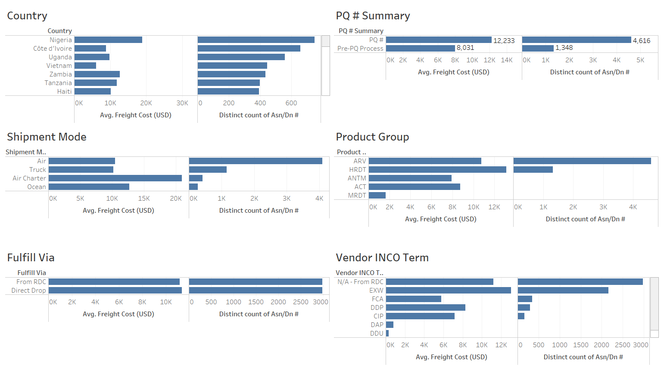
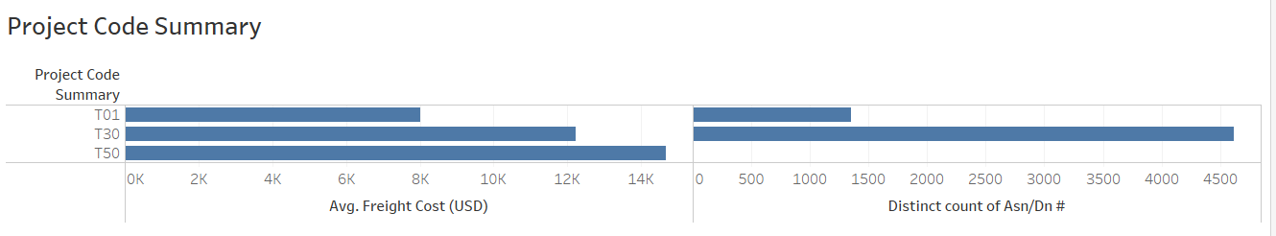
Feature Selection
I pulled the aggregated data into Tableau to observe the relationships between different features and freight cost.
When deciding which columns to keep, I considered which features would likely be significant based on the problem
I also looked for ways to summarize features with many different values.
PQ # and Project Code had many different values, but I noticed some patterns so I am going to see if summarizing these has a meaningful impact on the model
I also tried a large variety of feature combinations to see if it would improve the model

Slide 4
Building the Model
After dropping Weight and Freight Cost outliers, I wanted to see how the different numeric features were correlated to Freight Cost
After seeing which of the numeric features I created had a higher correlation to freight cost (Weight, Shipment Quantity, Shipment Value, Shipment Insurance), I decided to drop the other numeric features I had created (Number of IDs, Avg Shipment Unit Price, Shipment Unit of Measure (Per Pack), Avg Shipment Pack Price, Shipment Late)
I originally tried using SelectKBest to reduce the features included in the model in case of overfitting, but ultimately found this negatively impacted the model

Slide 5
Results of the Model
RandomForestRegressor
Relatively high training R2 (0.95) compared to test R2 score (0.73) indicates that the model is overfitting somewhat
0.73 is a relatively high R2 score, meaning that we are describing the variation in the target variable with our predictors relatively well
High RMSE ($3,427.51) and high MAE ($2,146.67) suggests that our predictions are off significantly
LinearRegression
Relatively low training R2 (0.42) and test R2 score (0.43) indicates that the model is not well fit to the data
High RMSE ($4,953.37) and high MAE ($3,390.58) suggests that our predictions are off significantly
XGBoost
Relatively high training R2 (0.91) compared to test R2 score (0.72) indicates that the model is overfitting somewhat
0.72 is a relatively high R2 score, meaning that we are describing the variation in the target variable with our predictors relatively well
High RMSE ($3,487.58) and high MAE ($2,181.68) suggests that our predictions are off significantly
XGB and Random Forest are relatively close. I will use hyperparameter tuning to see if I can improve RandomForestRegressor

Slide 6
Hyperparameter Tuning RandomForestRegressor
 | Without Hyperparameter Tuning | Using RandomizedSearchCV | Using GridSearchCV
MAPE | 0.91 | 0.92 | 0.93
R2 | 0.73 | 0.73 | 0.72
MSE | $11,747,805.72 | $11,548,547.97 | $12,050,582.41
RMSE | $3,427.51 | $3,398.32 | $3,471.39
MAE | $2,146.67 | $2,098.69 | $2,151.20

Slide 7
How I’d Improve the Model
I would want to see if we could collect other data that might be better indicators of freight cost
Distance from manufacturing site or DC to destination
Shipment requirements for goods
Does it need to be refrigerated
Lead time

